Slide 1
May 16th
Ainsley Lai

Slide 2
Topics
Database of studied ships
Name, Size, GT, DWT, Draught, Max speed (latter two differ by voyage)
dB difference in SPDF
Time of year, speed, distance from hphone
Comparing difference in SPDF for same ship type, different ships
Source Level Distribution

Slide 3
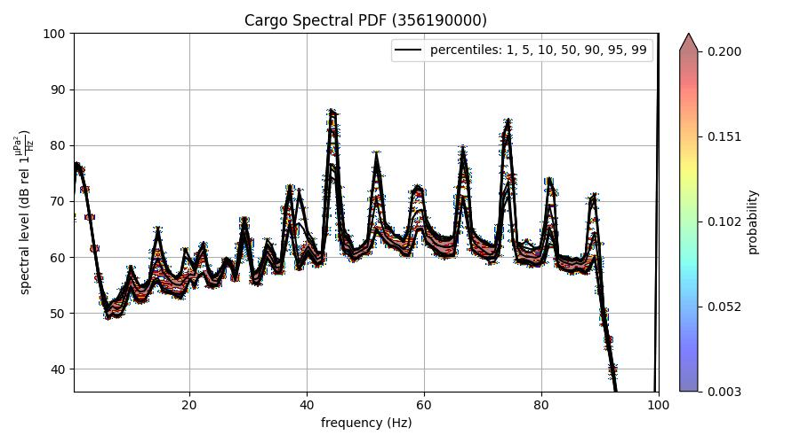
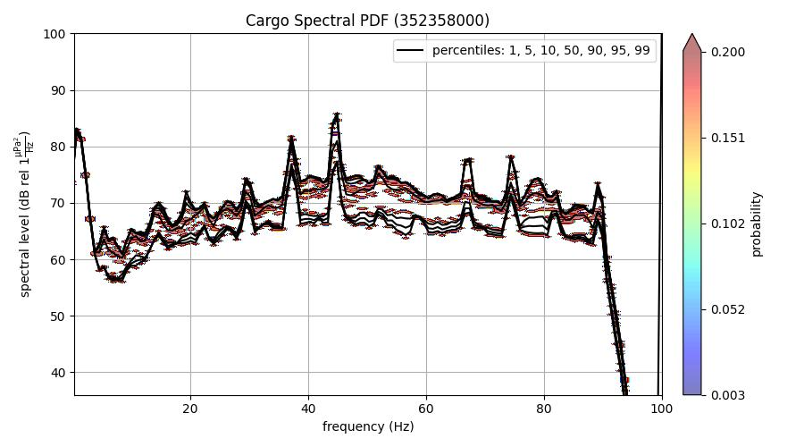
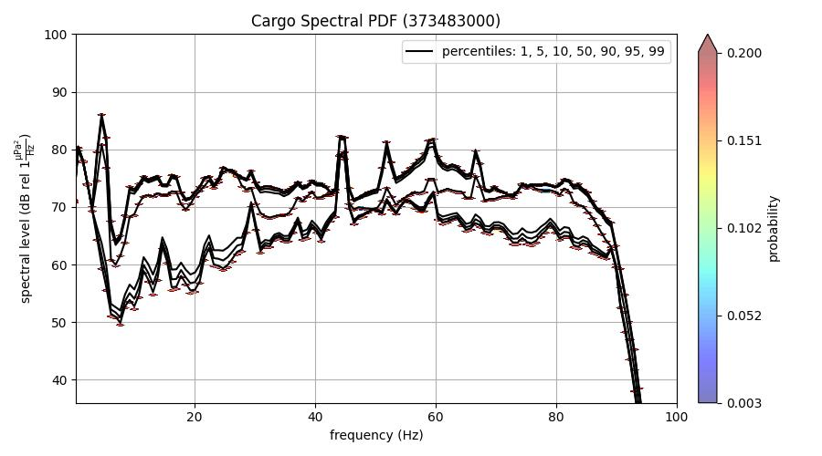
Comparing difference in SPDF for same ship type, different ships (Axial Base)
GT: 41662
DWT: 78844
Size: 225x32
GT: 119441
DWT: 131095
Size: 333.2x48.25
GT: 38731
DWT: 75563
Size: 225x32.26
>2km or >10 knots eliminates spread. Caused by little data?

Slide 4
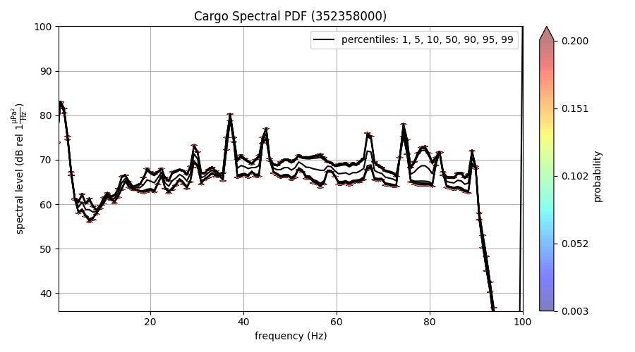
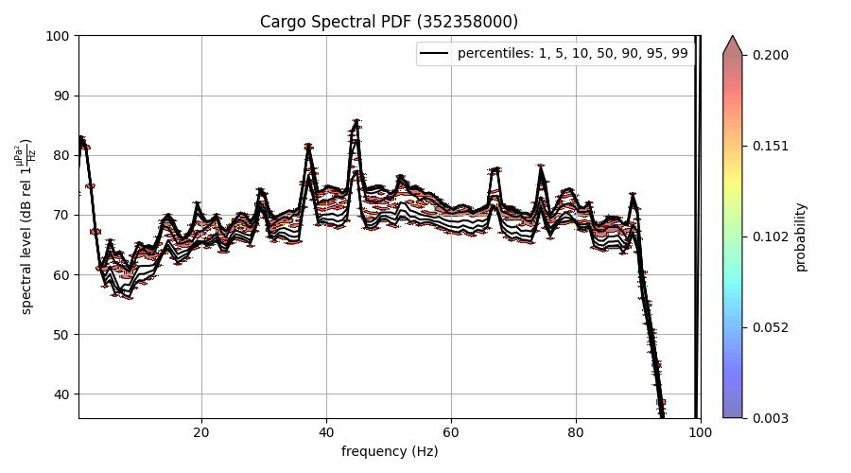

Slide 5
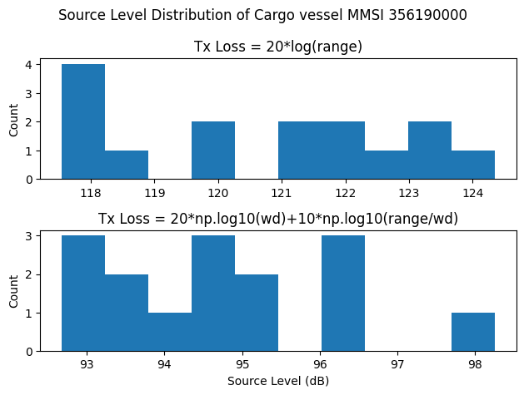
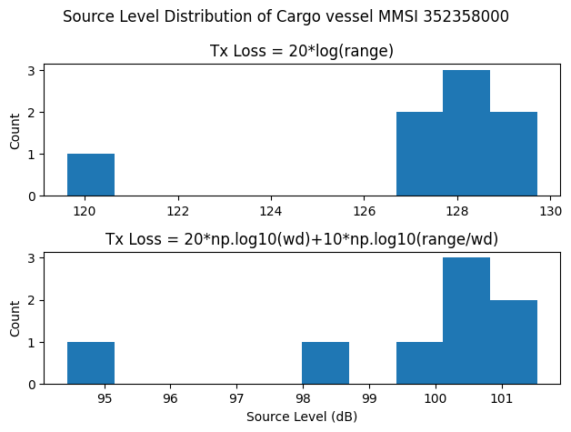
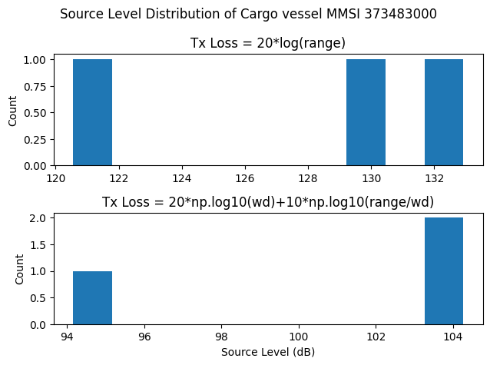
Source Level Distribution (2 different loss models)
GT: 41662
DWT: 78844
Size: 225x32
GT: 119441
DWT: 131095
Size: 333.2x48.25
GT: 38731
DWT: 75563
Size: 225x32.26
>2km or >10 knots eliminates spread. Caused by little data?

Slide 6
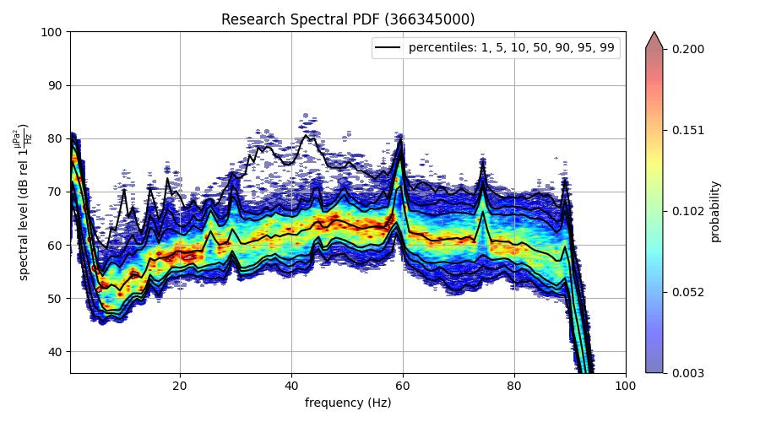
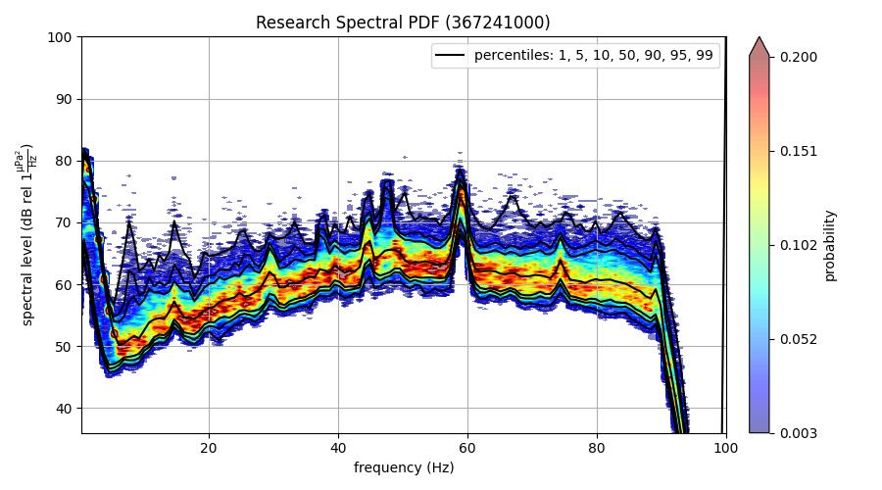
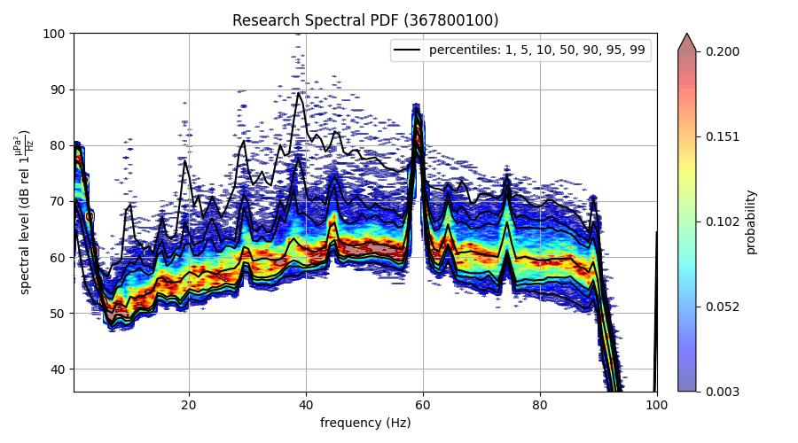
Comparing difference in SPDF for same ship type, different ships (Axial Base)
GT: 3095
DWT:
Size: 83.26x16
Difference not from speed/dist. from Hphone. Hump is in recordings earlier than 2020 (2015 recordings have hump).
GT: 3180
DWT:
Size: 83.27x16
GT: 3180
DWT:
Size: 83.26x16
Hump caused by 2018 recordings, speed/dist seems unimodal

Slide 7
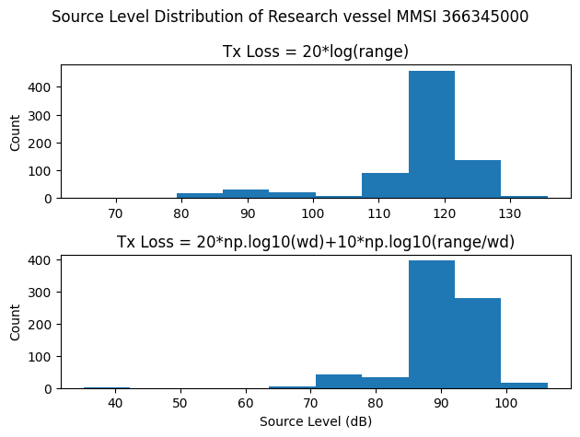
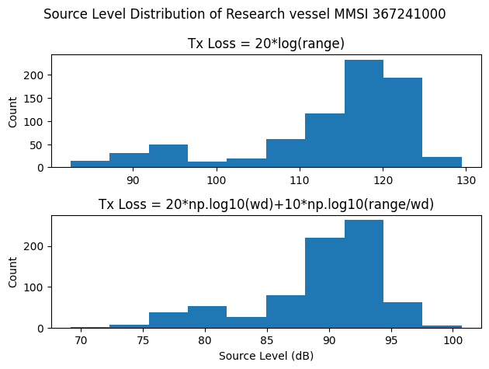
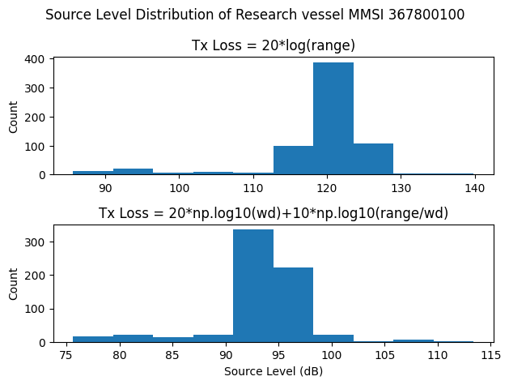
Source Level Distribution (2 different loss models)
GT: 3095
DWT:
Size: 83.26x16
Difference not from speed/dist. from Hphone. Hump is in recordings earlier than 2020 (2015 recordings have hump).
GT: 3180
DWT:
Size: 83.27x16
GT: 3180
DWT:
Size: 83.26x16
Hump caused by 2018 recordings, speed/dist seems unimodal

Slide 8
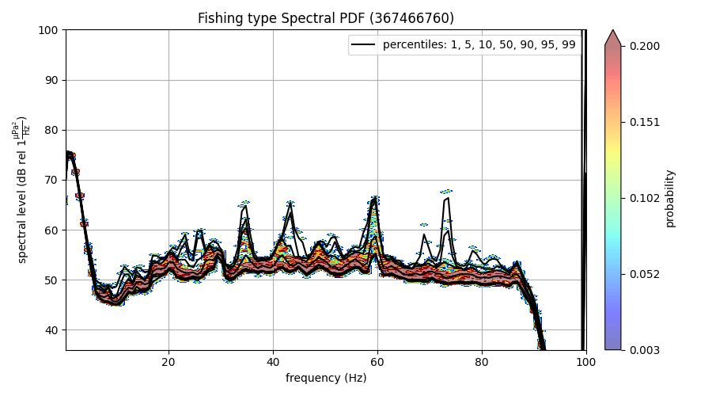
Comparing difference in SPDF for same ship type, different ships (Axial Base)
GT: 171
DWT:
Size: 27.24x7.31

Slide 9
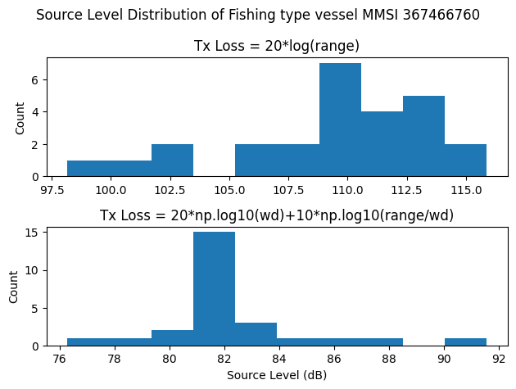
Source Level Distribution (2 different loss models)
GT: 171
DWT:
Size: 27.24x7.31

Slide 10
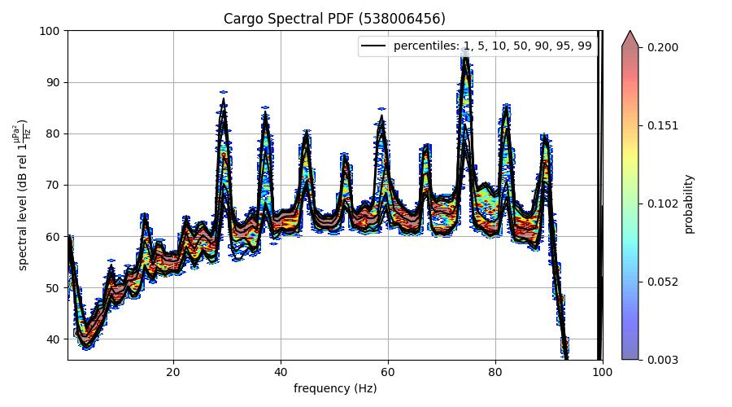
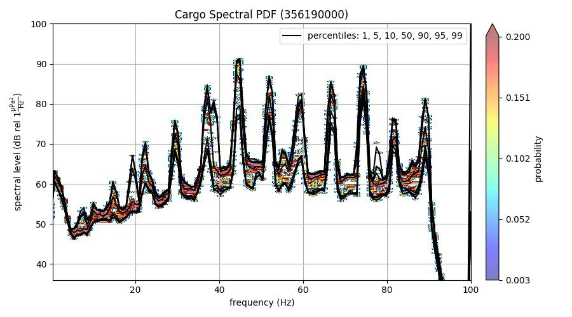
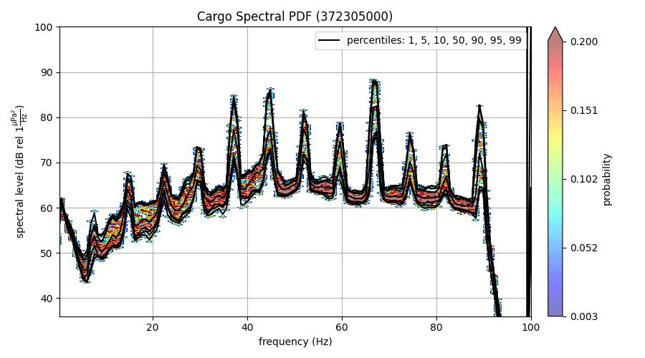
Comparing difference in SPDF for same ship type, different ships (Eastern Caldera)
GT: 23950
DWT: 38140
Size: 185x31
GT: 41662
DWT: 78844
Size: 225x32
GT: 35832
DWT: 63498
Size: 199.98x32.24

Slide 11
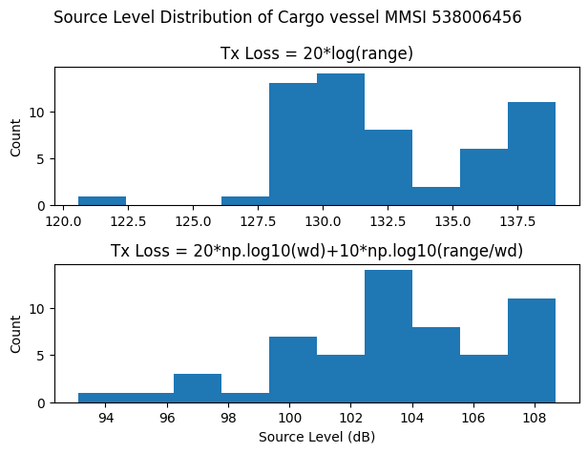
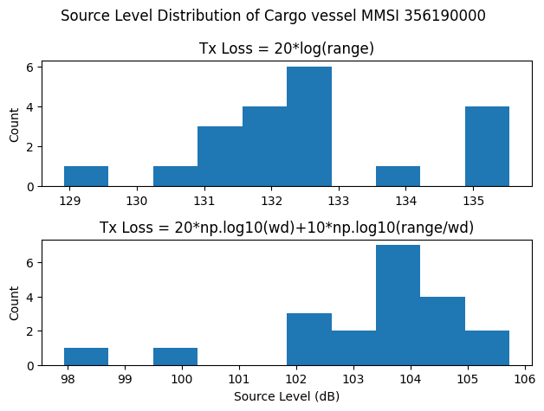
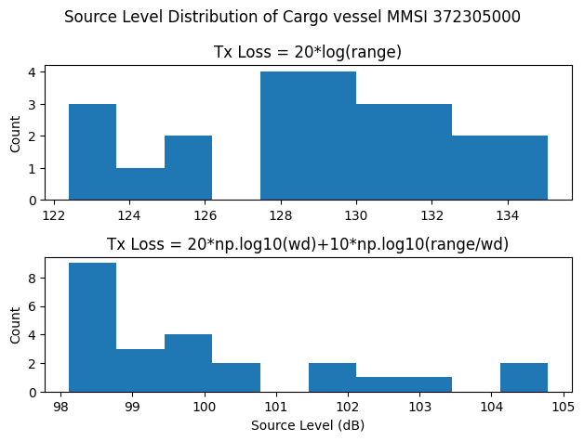
Source Level Distribution (2 different loss models)
GT: 23950
DWT: 38140
Size: 185x31
GT: 41662
DWT: 78844
Size: 225x32
GT: 35832
DWT: 63498
Size: 199.98x32.24

Slide 12
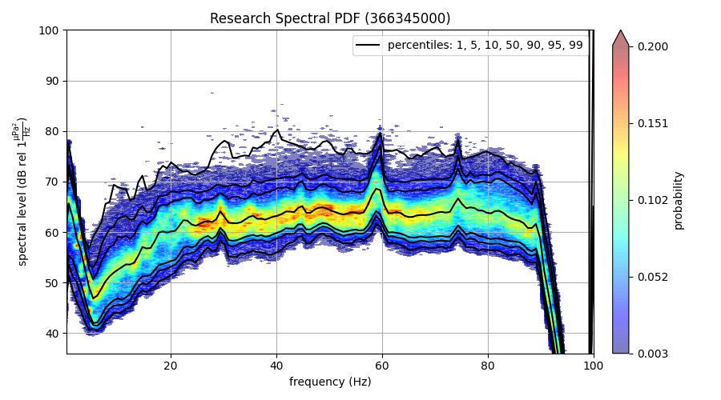
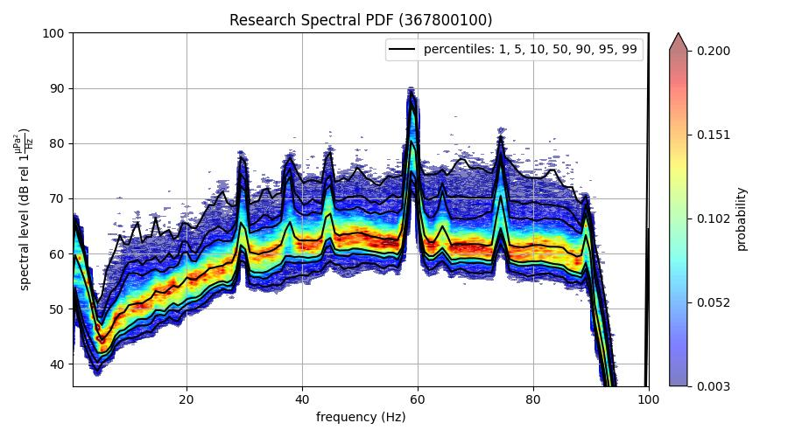
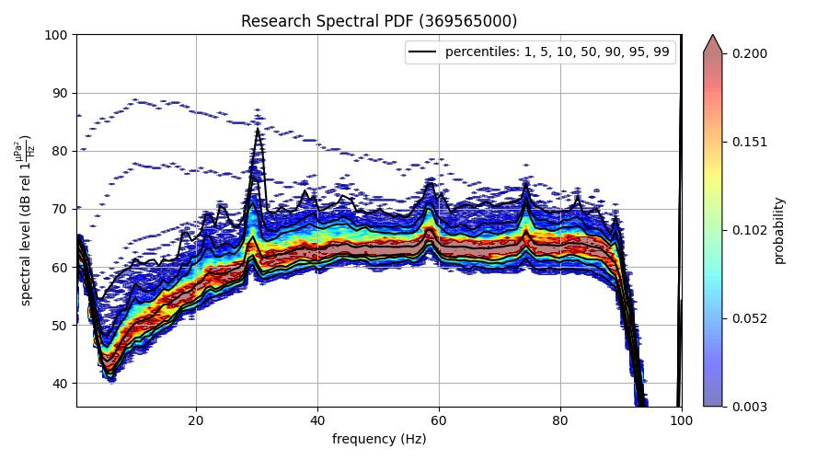
Comparing difference in SPDF for same ship type, different ships (Eastern Caldera)
GT: 3095
DWT:
Size: 83.26x16
GT: 3180
DWT:
Size: 83.26x16
GT: 3060
DWT: 150
Size: 56.57x26.82

Slide 13
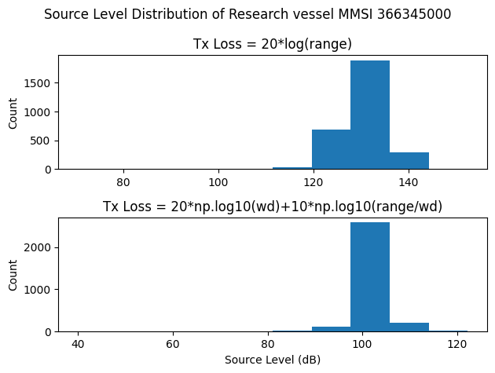
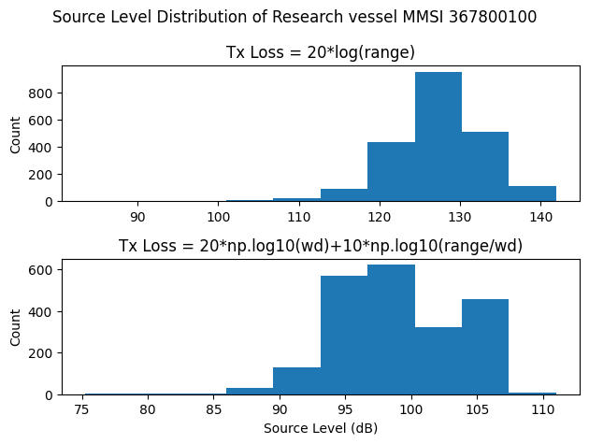
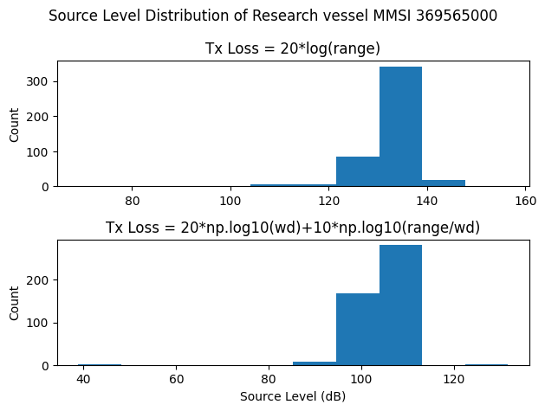
Source Level Distribution (2 different loss models)
GT: 3095
DWT:
Size: 83.26x16
GT: 3180
DWT:
Size: 83.26x16
GT: 3060
DWT: 150
Size: 56.57x26.82

Slide 14
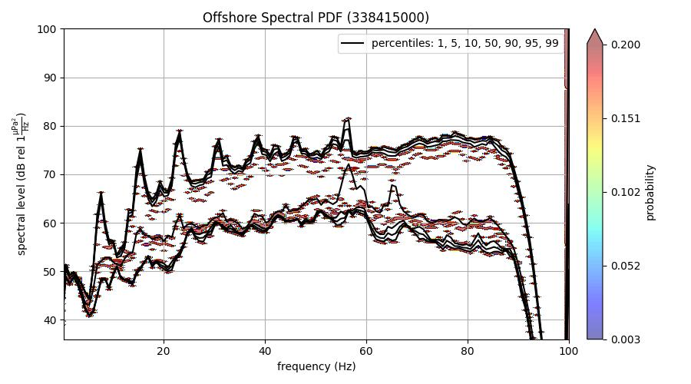
Comparing difference in SPDF for same ship type, different ships (Eastern Caldera)
GT: 430
DWT: 428
Size: 41.46x10.37

Slide 15
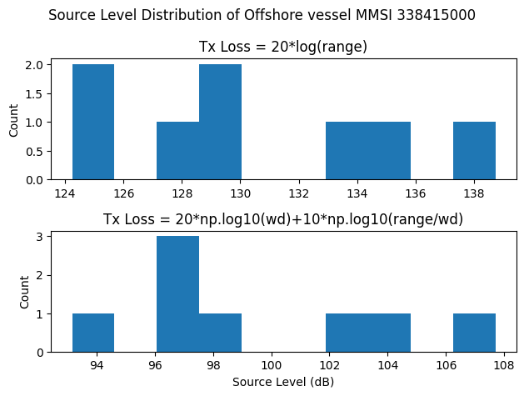
Source Level Distribution (2 different loss models)
GT: 430
DWT: 428
Size: 41.46x10.37

Slide 16
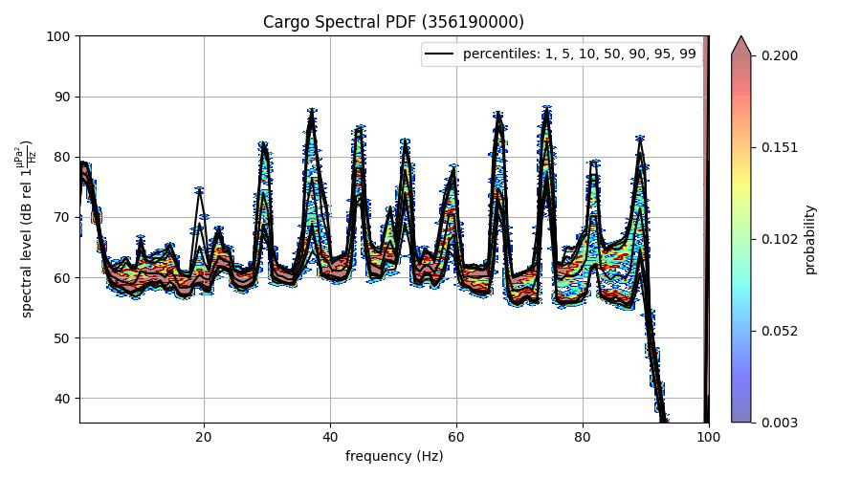
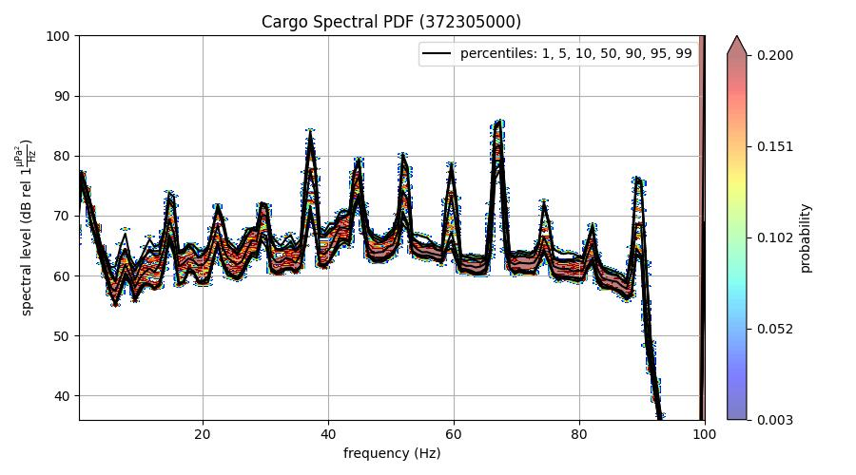
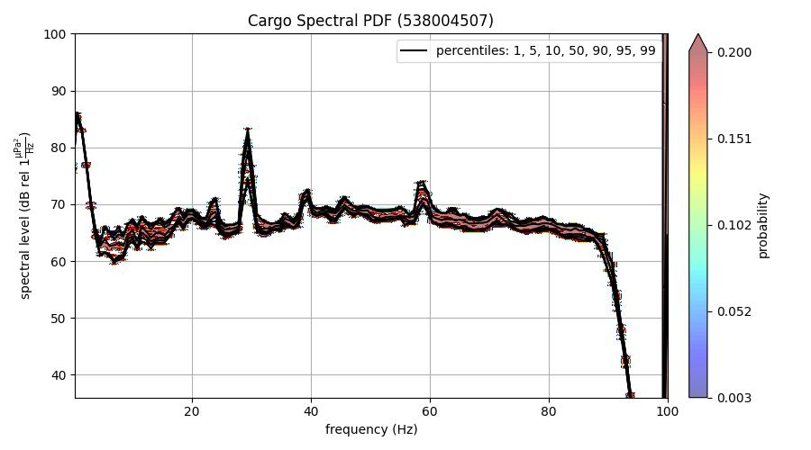
Comparing difference in SPDF for same ship type, different ships (Central Caldera)
GT: 41662
DWT: 78844
Size: 225x32
GT: 35832
DWT: 63498
Size: 199.98x32.24
GT: 44557
DWT: 81525
Size: 229x32.26

Slide 17
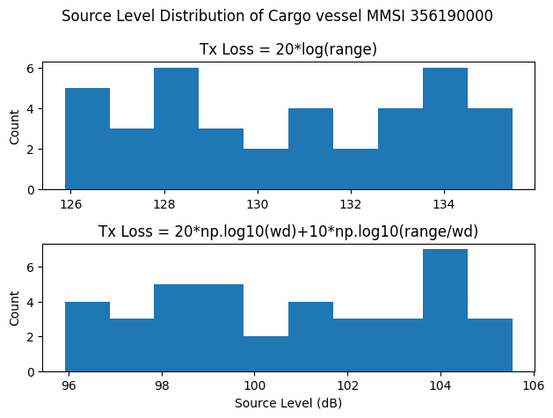
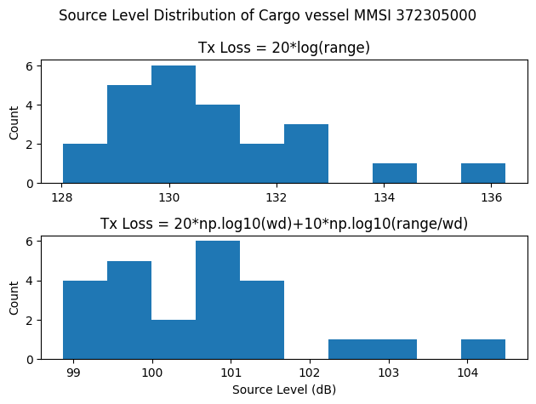
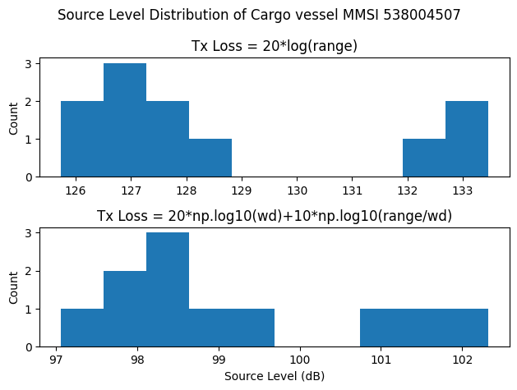
Source Level Distribution (2 different loss models)
GT: 41662
DWT: 78844
Size: 225x32
GT: 35832
DWT: 63498
Size: 199.98x32.24
GT: 44557
DWT: 81525
Size: 229x32.26

Slide 18
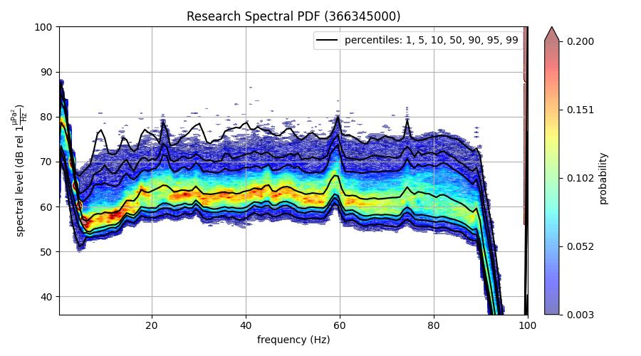
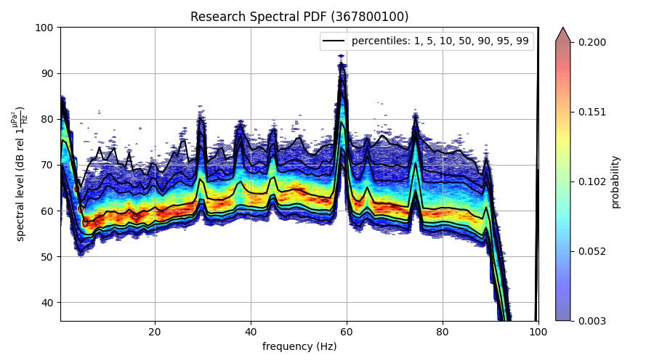
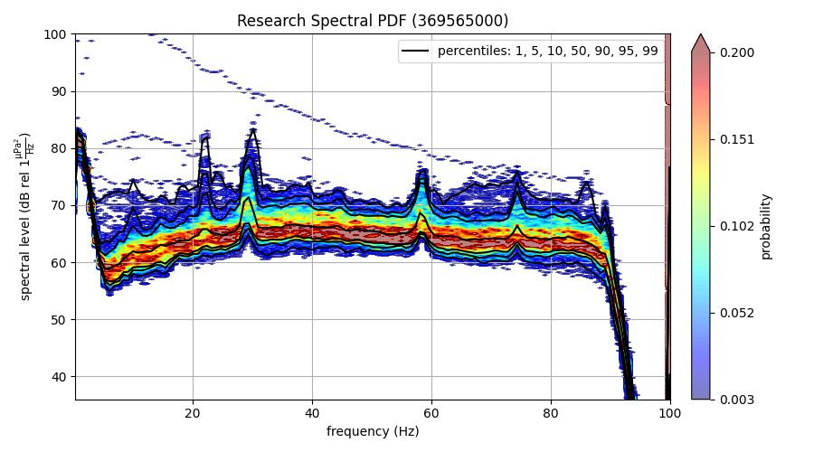
Comparing difference in SPDF for same ship type, different ships (Central Caldera)
GT: 3095
DWT:
Size: 83.26x16
GT: 3180
DWT:
Size: 83.26x16
GT: 3060
DWT: 150
Size: 56.57x26.82

Slide 19
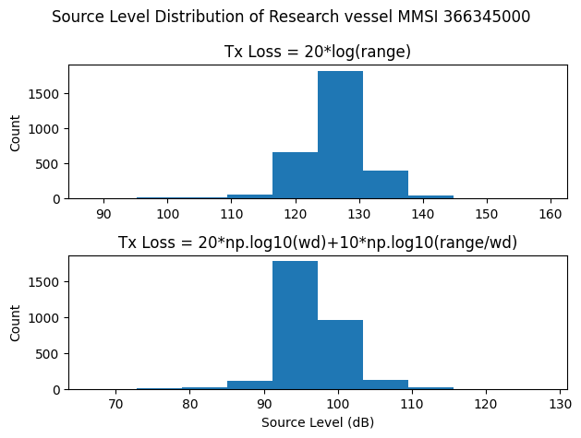
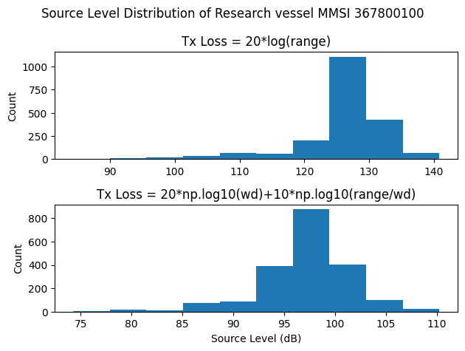
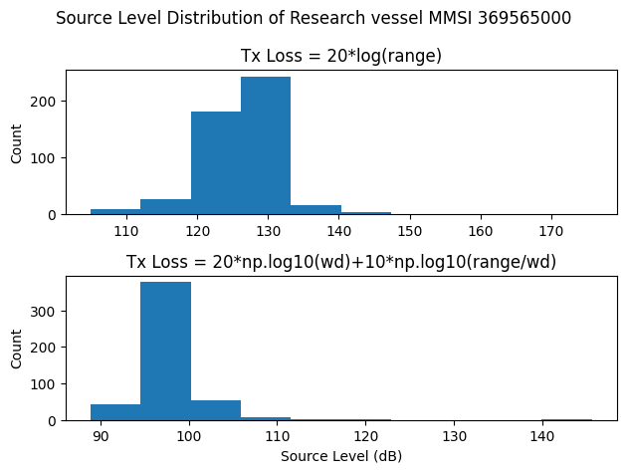
Source Level Distribution (2 different loss models)
GT: 3095
DWT:
Size: 83.26x16
GT: 3180
DWT:
Size: 83.26x16
GT: 3060
DWT: 150
Size: 56.57x26.82

Slide 20
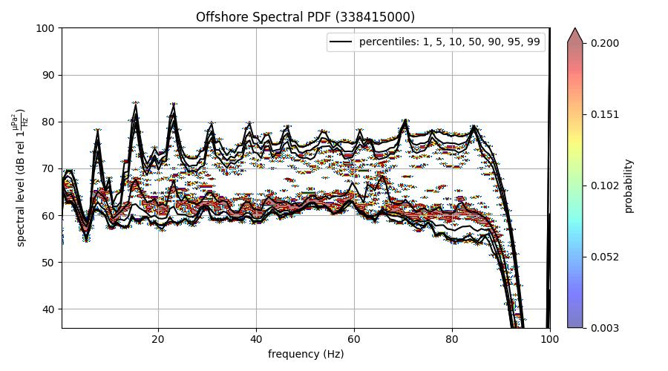
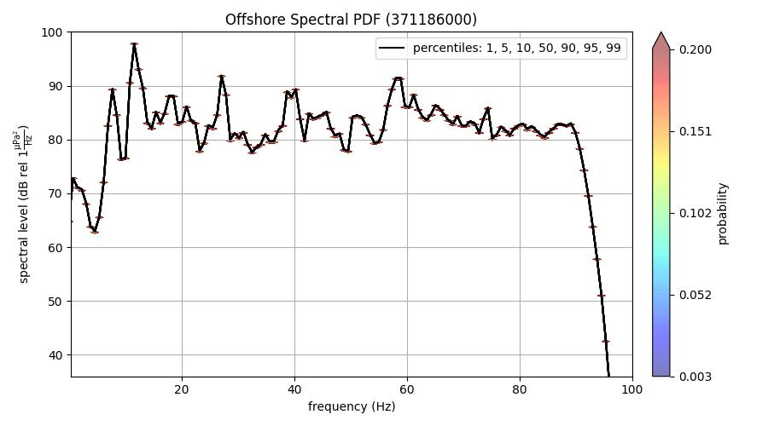
Comparing difference in SPDF for same ship type, different ships (Central Caldera)
GT: 430
DWT: 428
Size: 41.46x10.37
GT:
DWT: 63477
Size: 199.98x32

Slide 21
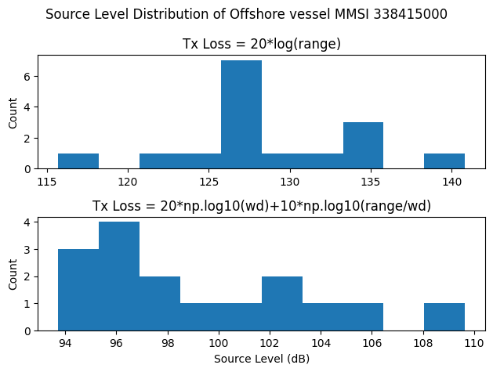
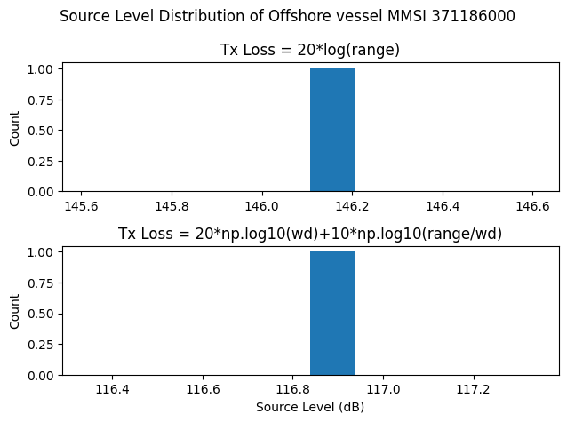
Source Level Distribution (2 different loss models)
GT: 430
DWT: 428
Size: 41.46x10.37
GT:
DWT: 63477
Size: 199.98x32

